Slide 1
Linked Lists
DATA STRUCTURES
LINK LISTS

Slide 2
Linked Lists
A linked list is a linear collection of data elements, called nodes, where the linear order is given by means of pointers.
Each node is divided into two parts:
  The first part contains the information of the element and
  The second part contains the address of the next node (link /next pointer field) in the list.

Slide 3
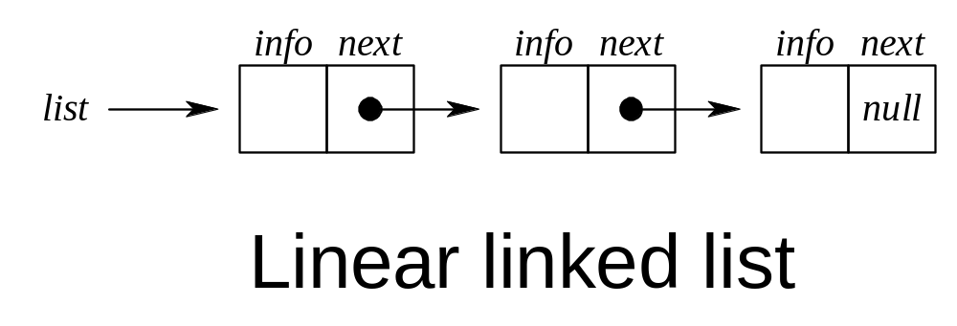
Linked Lists

Slide 4
Algorithm- Traversing Link List
Set PTR=Start
Repeat Steps 3 & 4 while PTR!=NULL
Apply Process to INFO[PTR]
Sep PTR=LINK[PTR]
(ptr now points to next node)
End of step 2 loop
5) Exit

Slide 5
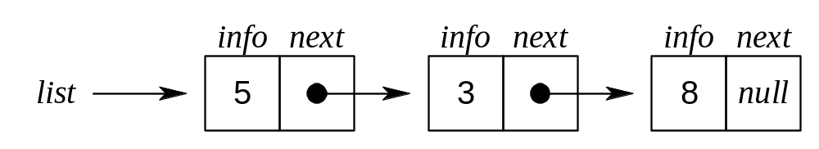
Adding an Element to the front of a Linked List

Slide 6
Some Notations for use in algorithm (Not in C programs)
p: is a pointer
node(p): the node pointed to by p
info(p): the information portion of the node
next(p): the next address portion of the node
getnode(): obtains an empty node
freenode(p): makes node(p) available for reuse even if the value of the pointer p is changed.

Slide 7
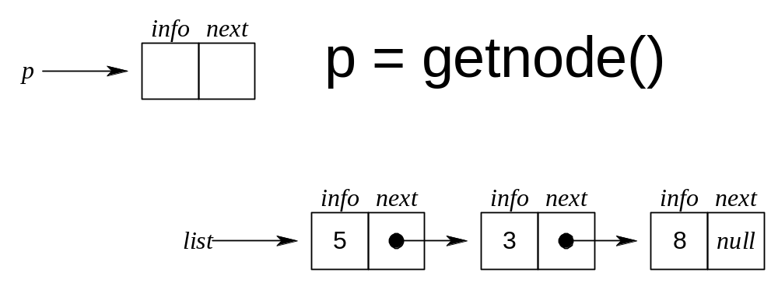
Adding an Element to the front of a Linked List

Slide 8
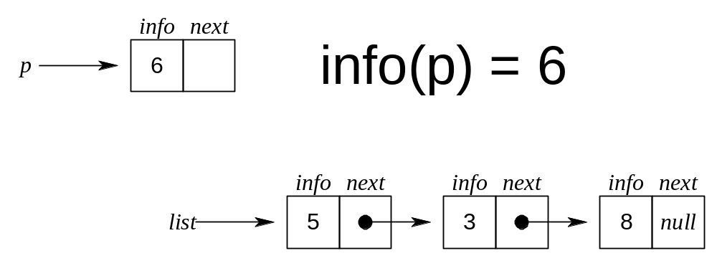
Adding an Element to the front of a Linked List

Slide 9
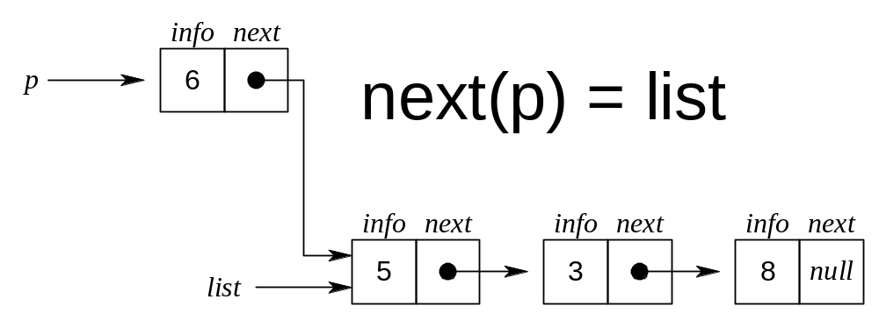
Adding an Element to the front of a Linked List

Slide 10
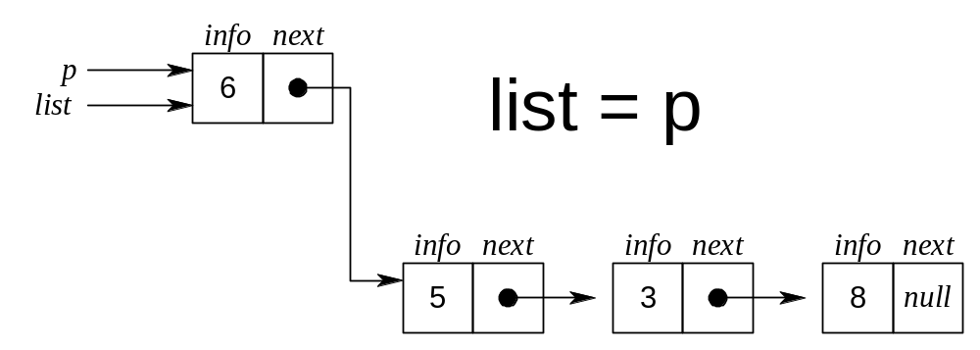
Adding an Element to the front of a Linked List

Slide 11
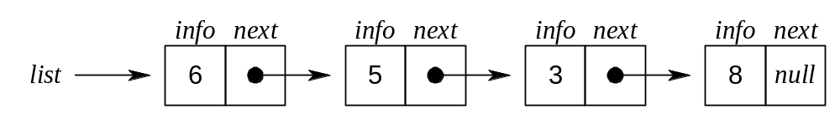
Adding an Element to the front of a Linked List

Slide 12
Removing an Element from the front of a Linked List

Slide 13
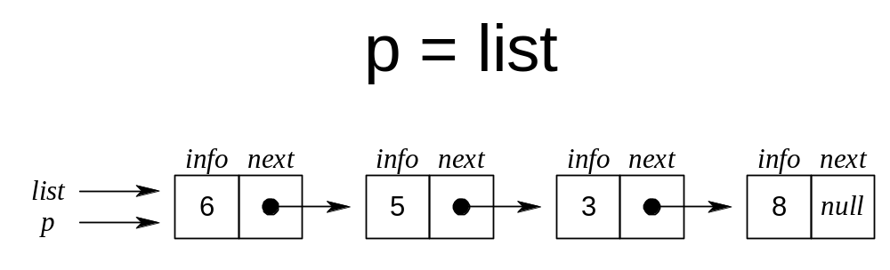
Removing an Element from the front of a Linked List

Slide 14
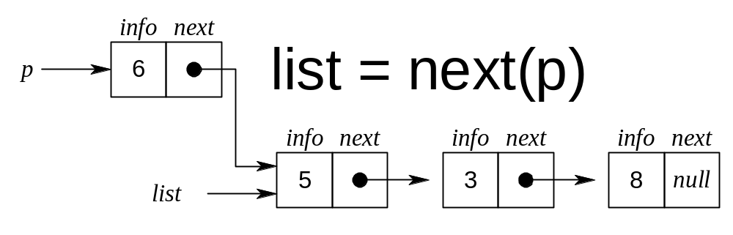
Removing an Element from the front of a Linked List

Slide 15
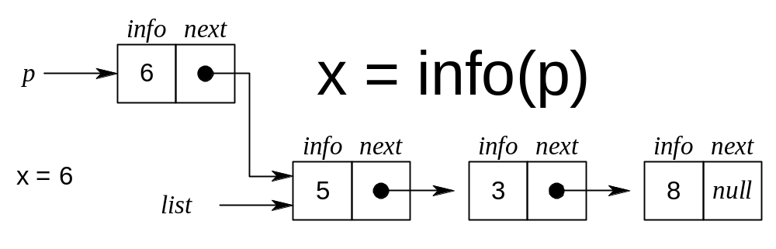
Removing an Element from the front of a Linked List

Slide 16
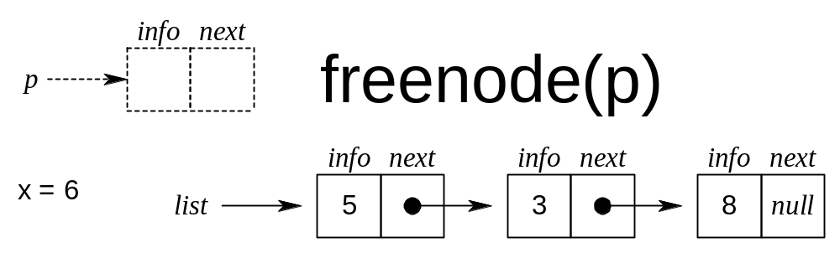
Removing an Element from the front of a Linked List

Slide 17
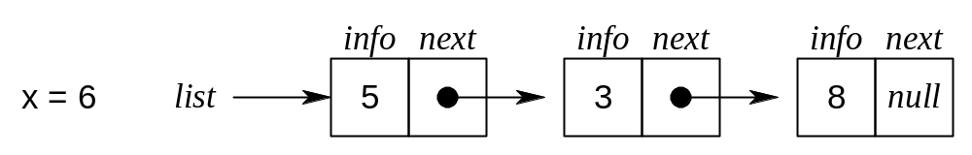
Removing an Element from the front of a Linked List

Slide 18
Linked List Implementation of Stacks – PUSH(S,X)
The first node of the list is the top of the stack. If an external pointer s points to such a linked list, the operation push(s,x) may be implemented by
    p=getnode();
    info(p)=x;
    next(p)=s;
    s=p;

Slide 19
Linked List Implementation of Stacks – POP(S)
The operation x=pop(s) removes the first node from a nonempty list and signals underflow if the list is empty:
    if (empty(s)){ /* checks whether s equals null */
    printf(‘stack underflow’);
    exit(1);
    }
    else {
    p =s;
    s=next(p);
    x = info(p);
    freenode(p);
    }

Slide 20
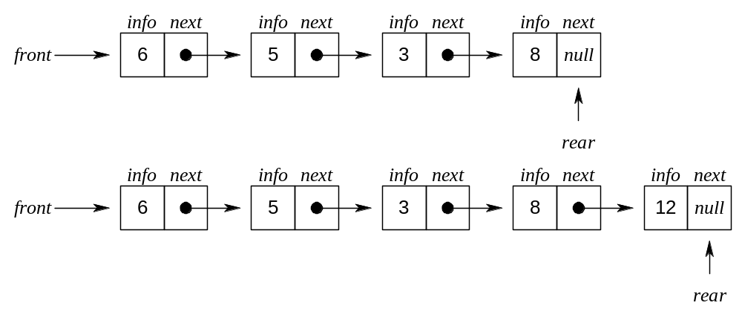
Linked List Implemantation of QUEUES

Slide 21
Linked List Implemantation of QUEUES
A queue q consists of a list and two pointers, q.front and q.rear. The operations empty(q) and x=remove(q) are completely analogous to empty(s) and x=pop(s), with the pointer q.front replacing s.
  if(empty(q)){
  printf(“queue undeflow”);
  exit(1);
  }
  p=q.front;
  x=info(p);
  q.front=next(p);
  if(q.front==null)
  q.rear=null;
  freenode(p);
  return(x);

Slide 22
Linked List Implemantation of QUEUES
The operation insert(q,x) is implemented by
  p= getnode();
  info(p)=x;
  next(p)=null;
  if(q.front==null)
  q.front=p;
  else
  next(q.rear)=p;
  q.rear=p;

Slide 23
Linked List as a Data Structure
An item is accesses in a linked list by traversing the list from its beginning.
An array implementation allows acccess to the nth item in a group using single operation, whereas a list implementation requires n operations.
The advantage of a list over an array occurs when it is necessary to insert or delete an element in the middle of a group of other elements.

Slide 24
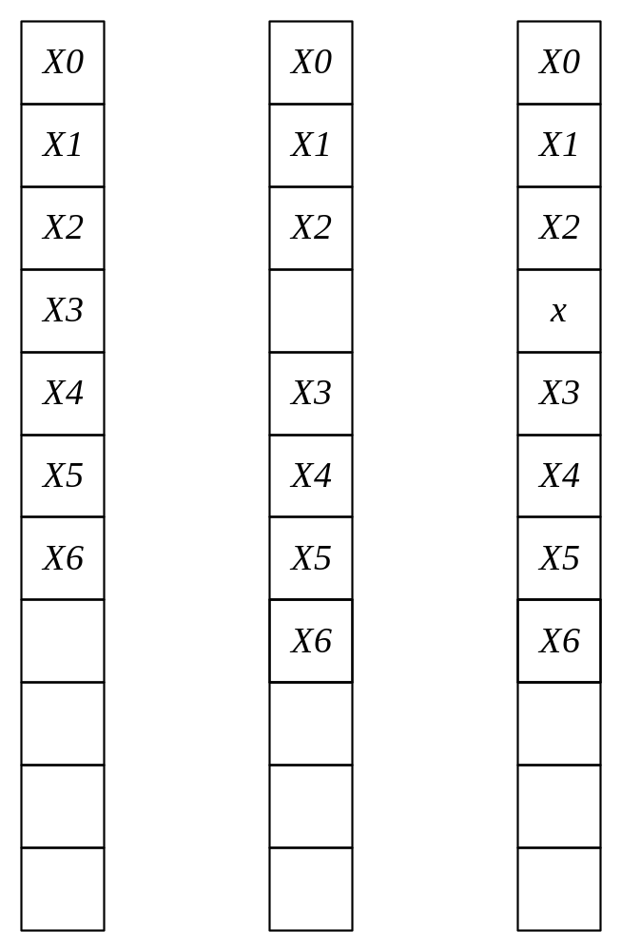
Element x is inserted between the third and fourth elements in an array

Slide 25
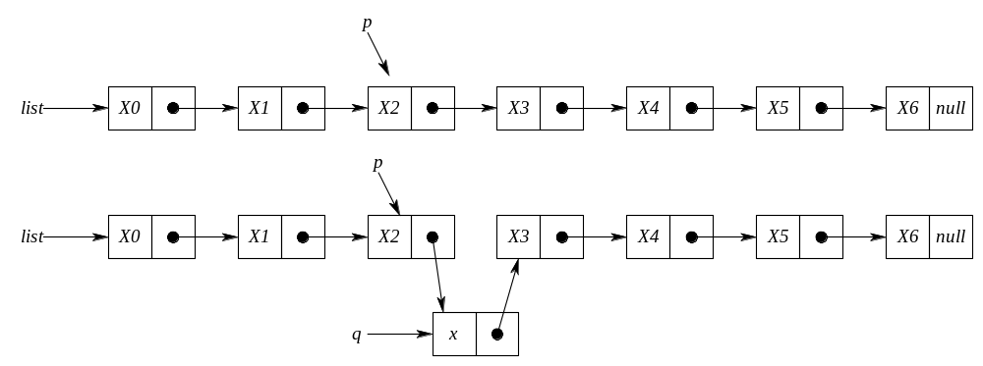
Inserting an item x into a list after a node pointed to by p

Slide 26
Inserting an item x into a list after a node pointed to by p
q=getnode();
info(q)=x;
next(q)=next(p);
next(p)=q;

Slide 27
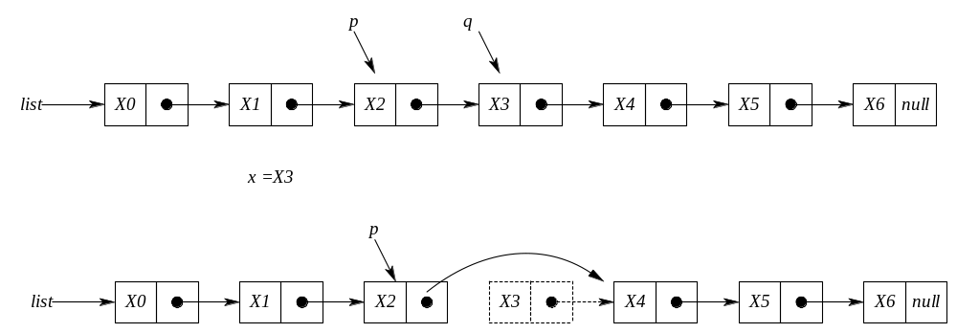
Deleting an item x from a list after a node pointed to by p

Slide 28
Deleting an item x from a list after a node pointed to by p
q=next(p);
x=info(q);
next(p)=next(q);
freenode(q);

Slide 29
LINKED LISTS USING DYNAMIC VARIABLES
In array implementation of the linked lists a fixed set of nodes represented by an array is established at the beginning of the execution
A pointer to a node is represented by the relative position of the node within the array.
In array implementation, it is not possible to determine the number of nodes required for the linked list. Therefore;
  Less number of nodes can be allocated which means that the program will have overflow problem.
  More number of nodes can be allocated which means that some amount of the memory storage will be wasted.
The solution to this problem is to allow nodes that are dynamic, rather than static.
When a node is required storage is reserved/allocated for it and when a node is no longerneeded, the memory storage is released/freed.

Slide 30
ALLOCATING AND FREEING DYNAMIC VARIABLES
C library function malloc() is used for dynamically allocating a space to a pointer. Note that the malloc() is a library function in <stdlib.h> header file.
The following lines allocate an integer space from the memory pointed by the pointer p.
  int *p;
  p = (int *) malloc(sizeof(int));
  Note that sizeof() is another library function that returns the number of bytes required for the operand. In this example, 4 bytes for the int.

Slide 31
ALLOCATING AND FREEING DYNAMIC VARIABLES
Allocate floating point number space for a float pointer f.
  float *f;
  f = (float *) malloc(sizeof(float));

Slide 32
Question:What is the output of the following lines?
  int *p, *q;
  int x;
  p = (int *) malloc(sizeof(int));
  *p = 3;
  x = 6;
  q = (int *) malloc(sizeof(int));
  *q=x;
  printf(“%d %d \n”, *p, *q);
The above lines will print 3 and 6.
p
p
3
x
6
q
q
6

Slide 33





malloc() and free()
The following lines and the proceeding figure shows the effectiveness of the free() function.
int *p, *q;
p = (int *) malloc(sizeof(int));
*p = 5;
q = (int *) malloc(sizeof(int));
*q = 8;
free(p);
p = q;
q = (int *) malloc(sizeof(int));
*q = 6;
printf(“%d %d \n”, *p, *q);

Slide 34
LINKED LISTS STRUCTURES AND BASIC FUNCTIONS
The value zero can be used in a C program as the null pointer. You can use the following line to declare the NULL constant. Note that a NULL pointer is considered NOT to point any storage location.
#define NULL 0
The following node structure can be used to implement Linked Lists. Note that the info field, which can be some other data type (not necessarily int), keeps the data of the node and the pointer next links the node to the next node in the Linked List.
struct node{
int info;
struct node *next;
};
typedef struct node *NODEPTR;

Slide 35
LINKED LISTS STRUCTURES AND BASIC FUNCTIONS
When a new node is required (e.g. to be inserted into the list) the following function, getnode, can be used to make a new node to be available for the list.
NODEPTR getnode(void)
{
NODEPTR p;
p = (NODEPTR) malloc(sizeof(struct node));
return p;
}

Slide 36
LINKED LISTS STRUCTURES AND BASIC FUNCTIONS
When a new node is no longer used (e.g. to be deleted from the list) the following function, freenode, can be used to release the node back to the memory.
void freenode(NODEPTR p)
{
free(p);
}

Slide 37
PRIMITIVE FUNCTIONS FOR LINEAR LINKED LISTS
The following functions insertafter(p,x) and delafter(p,px) are primitive functions that can be used for the dynamic implementation of a linked list. Assume that list is a pointer variable pointing the first node of a list (if any) and equals NULL in the case of an empty list.

Slide 38
void insertafter(NODEPTR p, int x)
{
NODEPTR q;
if(p == NULL){
printf("void insertion\n");
exit(1);
}
q=getnode();
q->info = x;
q->next = p->next;
p->next = q;
}

Slide 39
void delafter(NODEPTR p , int *px)
{
NODEPTR q;
if((p == NULL) || (p->next == NULL)){
printf("void deletion\n");
exit(1);
}
q = p->next;
*px = q->info;
p->next = q->next;
freenode(q);
}

Slide 40
Searching through the linked list.
The following function searches through the linked list and returns a pointer the first occurrence of the search key or returns NULL pointer if the search key is not in the list. Note that the linked list contains integer data items.

Slide 41
NODEPTR searchList(NODEPTR plist, int key)
{
  NODEPTR p;
  p = plist;
  while(p != NULL){
    if(p->info == key)
      return p;
    p = p->next;
  }
  return NULL;
}

Slide 42
Displaying the linked list elements
Write a function to display the student with highest CGPA in a linked list containing student data. Use the following node structure for your linked list.
  struct node{
    int stNo;
    float CGPA;
    struct node *next;
  };
  typedef struct node *NODEPTR;

Slide 43
void DisplayMax(NODEPTR plist)
{
NODEPTR p;
float maxCGPA=-1.0;
int maxstNo;
p = plist; /*current node*/
if(p == NULL){
  printf(“no node/data is available in the list\n”);
  return;
}
do{
  if(p->CGPA > maxCGPA){
    maxCGPA = p->CGPA;
    maxstNo = p->stNo;
  }
  p = p->next;
} while(p!= NULL);
printf(“The student number with max CGPA: %d\n”, maxstNo);
printf(“The student’s CGPA: %d\n”, maxCGPA);
}

